Slide 1
Research Methodology in Health Sciences
(Epidemiology + Statistics)
Önder Ergönül, MD, MPH
Professor of Infectious Diseases and Clinical Microbiology
Koç University, School of Medicine
Summer Course on Research Methodology in Medical Sciences
June 15-19, 2015, Istanbul

Slide 2
Current tasks
Chair, Infectious Diseases Department, American Hospital
President, Turkish Society of Clin Microbiol & Infectious Diseases www.klimik.org.tr
Full member, Academy of Science, Turkey
Associate editor, Clinical Microbiology and Infection
Executive Board Member, Eur Study Group on Antibiotic Policy, ESCMID
World Council member, International Society of Infect Dis (ISID)

Slide 3
Work and Education
Institution | Year | Area
KUSOM | 2011- | Infect Dis & Public Health
Marmara University | 2006-11 | Infect Dis & Clin Microbiology
Ankara Numune Training and Research Hosp. | 2003-06 | Infect Dis & Clin Microbiology
University of Utah | 2000-02 | Infect Dis & Clin Epidemiol
Harvard University, School of Public Health | 2001-03 | Master of Public Health, “quantitative methods”
Ankara University | 1990-95 | Residency, Infect Dis & Clin Mic
Hacettepe University | 1982-89 | Medical School

Slide 4
Aims
Summer Course on Research Methodology in Medical Sciences
June 16-20, 2014, Istanbul
Read a scientific manuscript
Write a scientific manuscript
Study design
P value
Effect estimates (relative risk, odds ratio, hazard ratio)
Interpretations of the study results
Learning Objectives

Slide 5
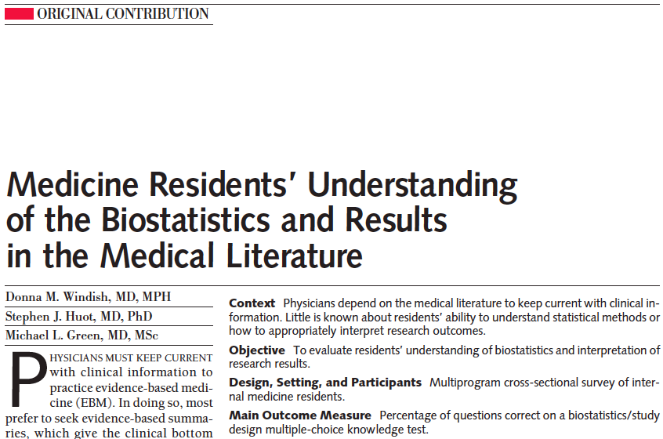
JAMA 2007

Slide 6
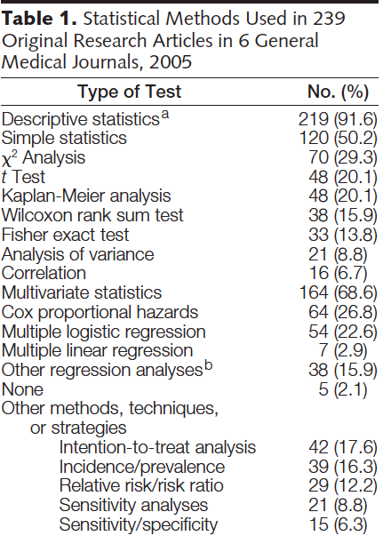
JAMA 2007

Slide 7
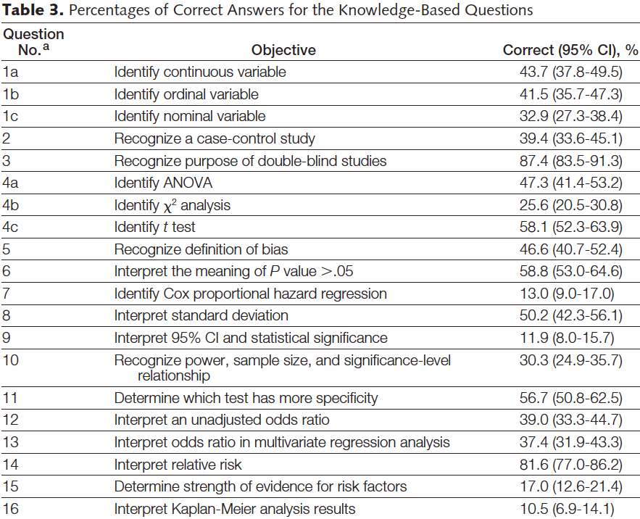
JAMA 2007

Slide 8
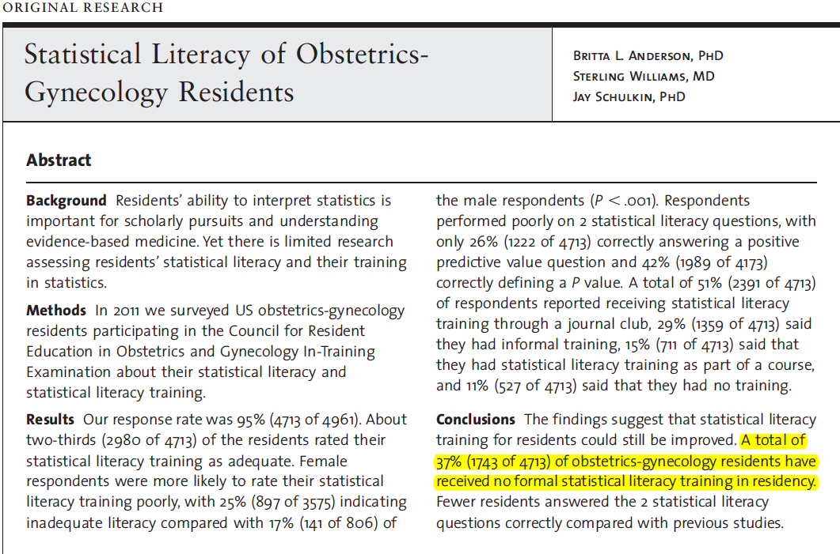

Slide 9
Objectives of the talk
Emergence and development of epidemiology
Historical remarks
Measuring disease occurence

Slide 10
What is Epidemiology?
“A discipline, which explores the causality of the diseases”
“A discipline, which divides the people into groups”
“Epidemiology is not to miss the forest, while looking at the trees”
“Epidemiology is to establish the association between the exposures and the outcome”

Slide 11
Epidemiology
Identify causes and risk factors for disease
Determine the extent of disease in the community
Study natural history and prognosis of disease
Evaluate preventive and therapeutic measures
Provide foundation for public policy
6. Evidence based medicine for decision making

Slide 12
EPI (on/ upon) + DOMOS (people) + OLOGY (Study)
Agent
Host
Environment
Why was the agent present
in the environment
Symptoms,
Progress
Who, when
Where, how

Slide 13

I keep six honest serving men, they taught me all I knew. Their names are
what,
why,
when,
how,
where,
who.
Rudyard Kipling, 1865-1936

Slide 14
The Evolution of Epidemiology in Modern Era
Graunt; Natural and Political Observations on the Bills of Mortality
1835 Farr; Mortality, life tables
1854 Snow; cholera
1950-80 Boom for Epidemiology: cohort studies
>2000 Emerging infections, genetics, cardiology
Rothman K, IJE 2007

Slide 15
William Farr (1807-1883)
In Great Britain medical registration of deaths had been introduced in 1801 and in 1838 William Farr introduced a national system of recording causes of death.
Once the mechanism started to work it provided a wealth of data which Farr himself first analyzed with great skill, making full use of life table techniques (close in most details to those in present day use) and of procedures for standardizing rates.
He was also instrumental in building up a classification of diseases for statistical purposes, at both national and international levels.

Slide 16
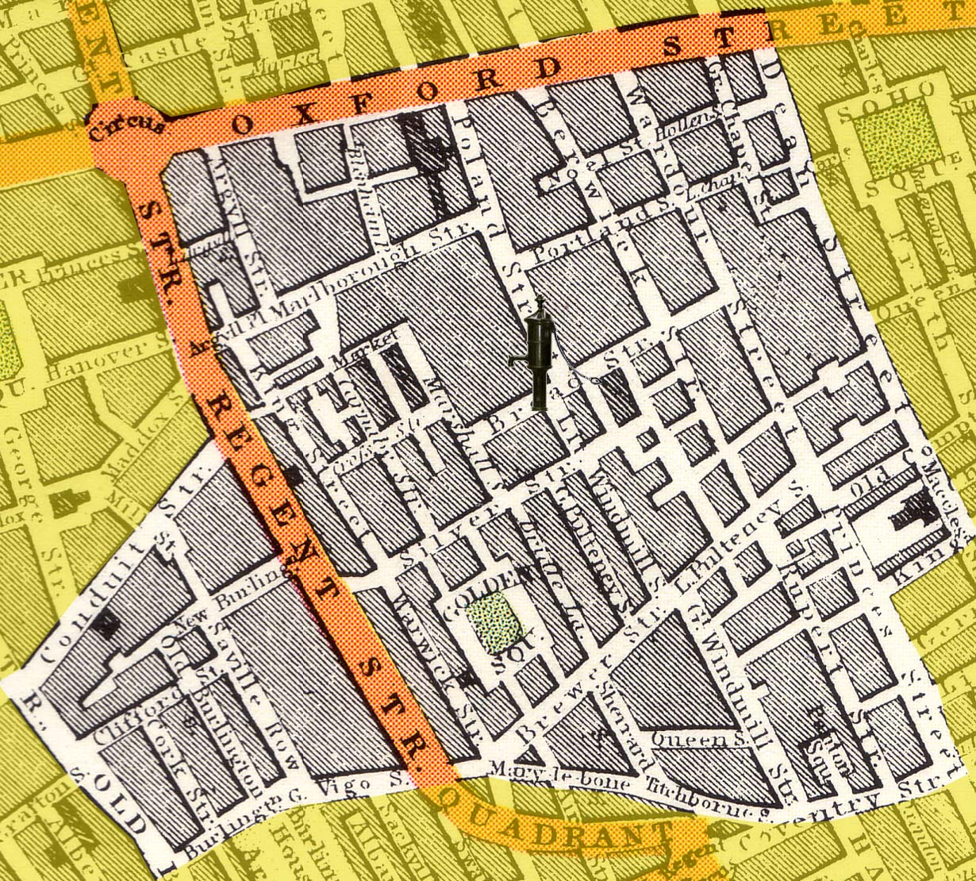
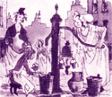
London 1843

Slide 17
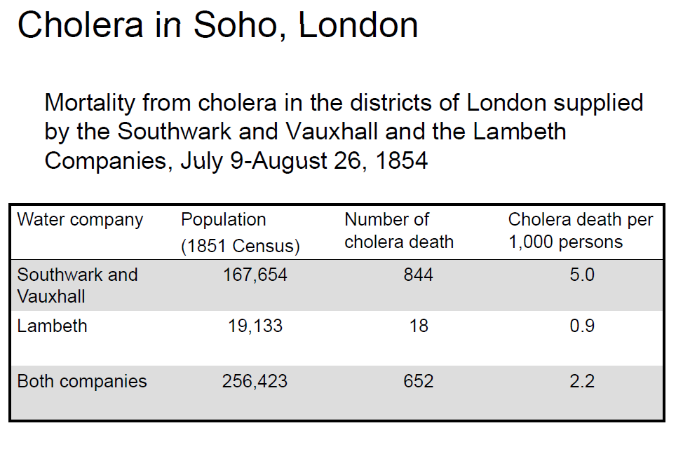

Slide 18
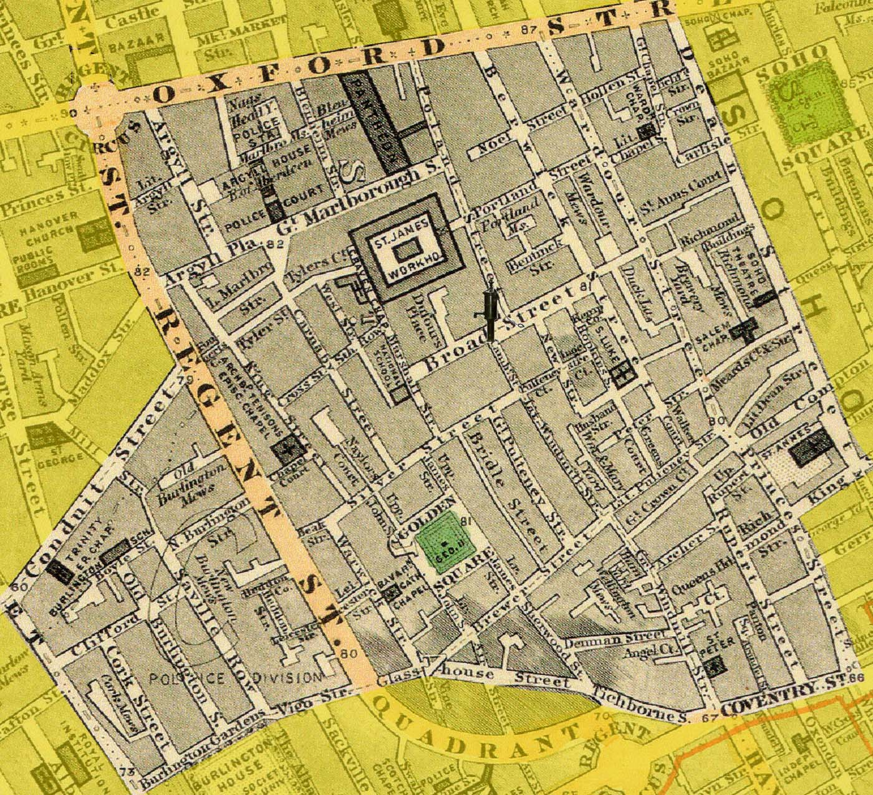
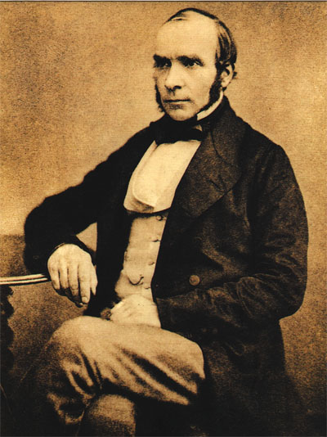
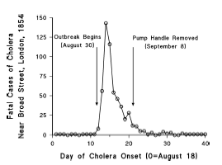
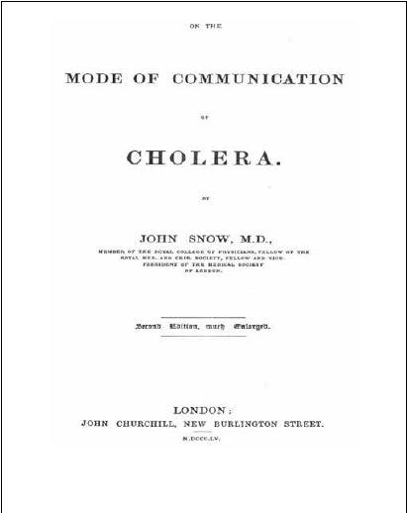
1855

Slide 19
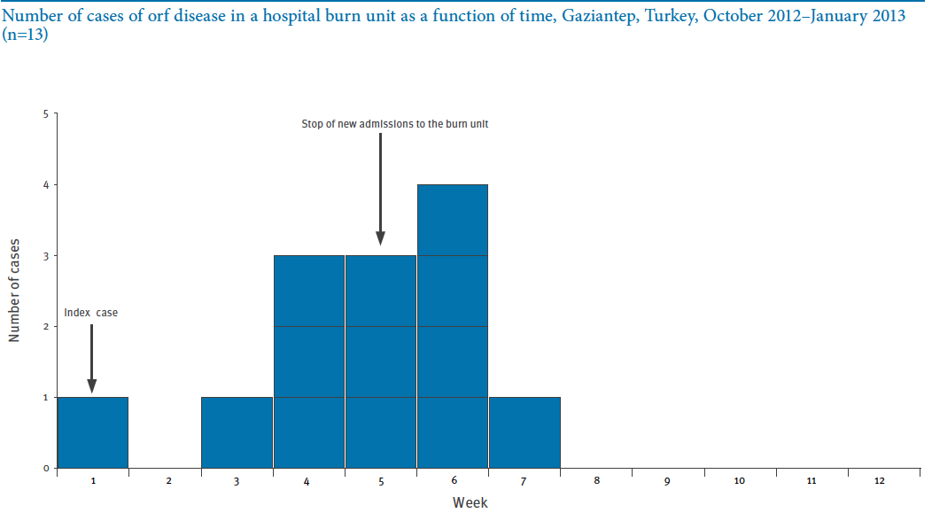

Slide 20
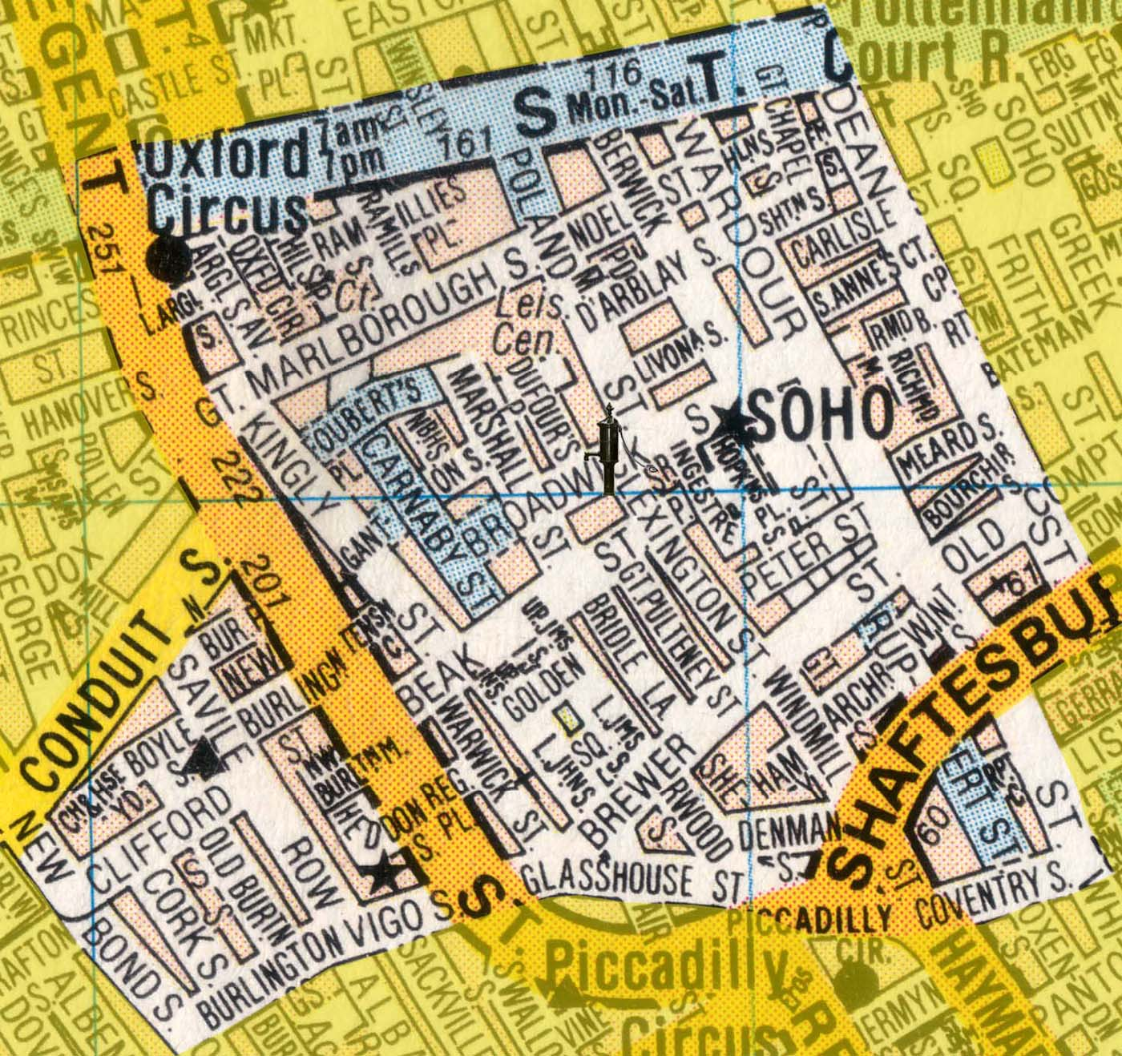
London 1998

Slide 21
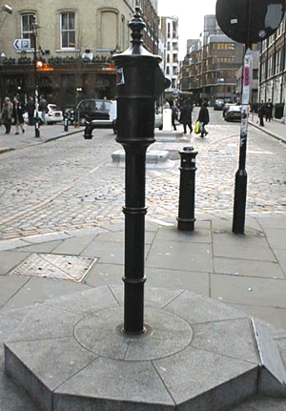

1831-1832 22 000 deaths
1848-1849 52 000 deaths
1853-1854 John Snow’s studies
The last outbreak: 1866 2 200 deaths

Slide 22
The Revolutionary Steps in Public Health in recent 200 years
The use of chlorine in the water
Snow removed the handle of the pump
Koch Germ theory
Malaria control
Polio eradication
1850
1882
1915
1963
2001
1796
1853
1885
1944
1953
1977
Jenner smallpox vaccine
Smallpox vaccine is obligatory in UK
Pasteur
Rabies vaccine, pasteurization
Penicillin
Salk polio vaccine
Smallpox eradication

Slide 23
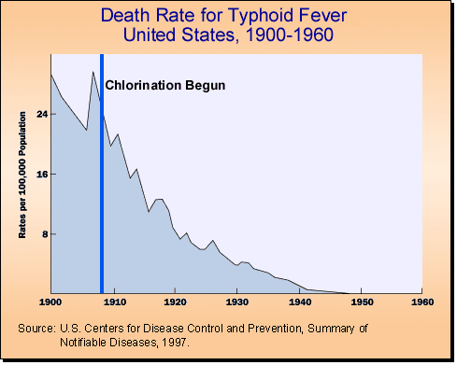

Slide 24
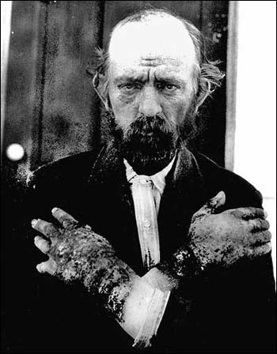
Pellagra: mal de la rosa
Firstly identified among Spanish peasants by Don Gaspar Casal in 1735.
4 D: dermatitis, diarrhea, dementia, death.
In 1937 it was discovered that pellagra
was caused by a deficiency of the B vitamin niacin (nicotinic acid). The body’s synthesis of this vitamin depends on the availability of the essential amino acid, tryptophan, which is found in milk, cheese, fish, meat and egg.

Slide 25
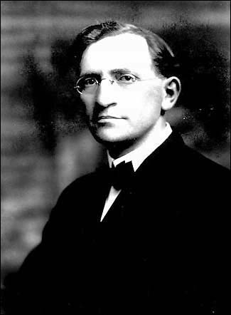
The Cause of Pellegra: Diet versus Germ?
1912, South Carolina, 30,000 cases of pellagra, with a case fatality rate of 40 per cent.
The disease was not confined to Southern states, however, and the US Congress asked the Surgeon General to investigate the disease. In 1914 he appointed Joseph Goldberger (1874-1929), a medical officer in the US Public Health Service, to lead the investigation.

Slide 26
The Role of Observational Studies
Goldberger believed that an infectious disease was unlikely to distinguish between inmates and employees or so systematically between rich and poor, and he favoured the hypothesis that a superior diet protected people from pellagra. He had also in mind the case of beri-beri, a disease which had recently been shown to be responsive to dietary interventions. (Vandenbroucke 2003).

Slide 27
Leukemia in Shoeworkers Exposed Chronically to Benzene
  Shoeworkers benzene leukemia
  Muzaffer Aksoy, Blood, 1974
Notes:
Çalışma yapmanın motivasyonu klinik süreçlerde bir sorunu çözmek için gerekli bilgileri toplamak ve bu sayede sorun çözmek olarak özetlenebilir. Muzattfer Aksoy tarafından 1970’li yıllların başlarında epidemiyoloji verilerinin kullanılarak ayakkabıcı çocuklarda göreceli olarak daha fazla görülen löseminin benzen maruziyetine bağlı olduğunun ileri sürülmesi gözlemsel epidemiyoloji çalışmalarının güzel bir örneğidir. Daha sonra benzenin lösemiye yol açtığı deneysel çalışmalarla kanıtlanmıştır.

Slide 28
Int J Antimicrobial Agents 2008

Slide 29
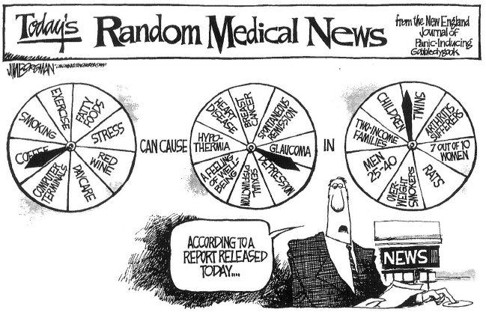

Slide 30
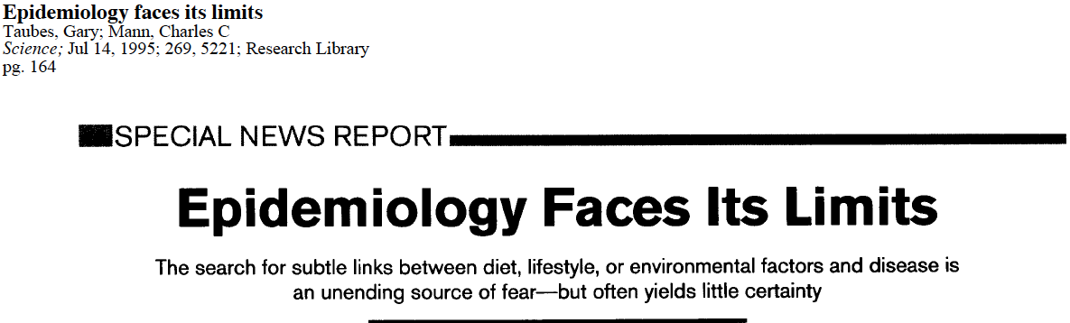

Slide 31
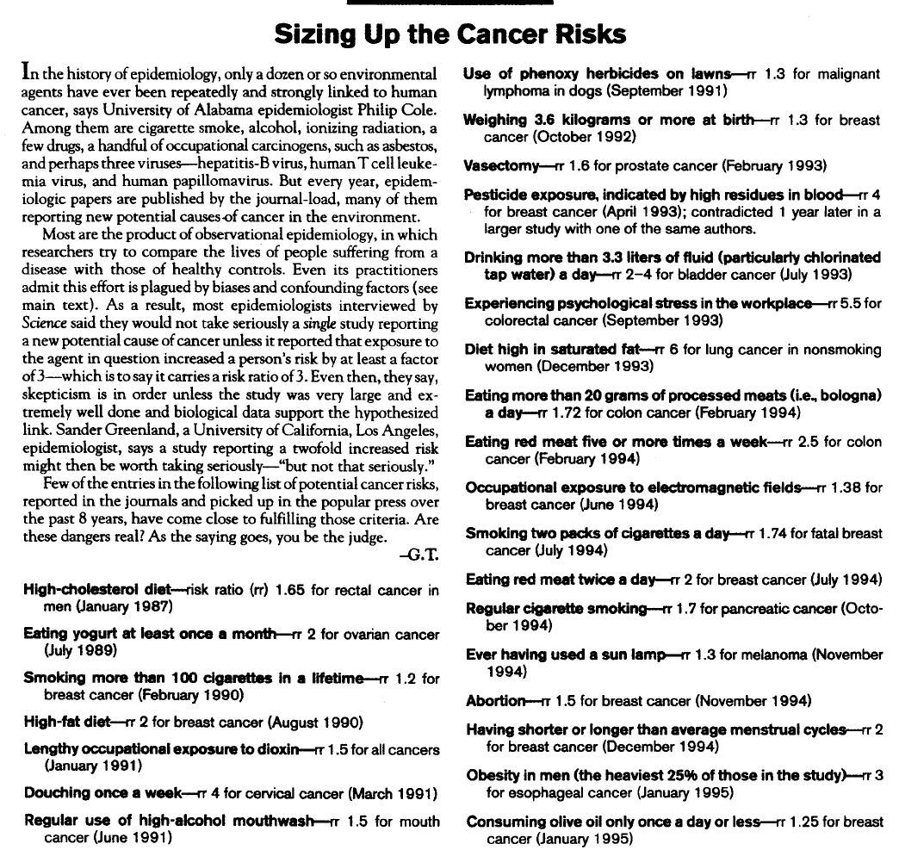

Slide 32
The Causal Pie Model
B
C
A
F
E
G
C
A
H
E
I
C
A
J
E

Slide 33
Causal Relation between Independent and dependent variables
B
A
C
OUTCOME

Slide 34
Interpretation of an epidemiologic study
Is there a valid statistical association?
Is the association likely to be due to chance?
Is the association likely to be due to bias?
Is the association likely to be due to confounding?
Can this valid association be judged as cause and effect?
Is there a strong association?
Is there biologic credibility to the hypothesis?
Is there consistency with other studies?
Is the time sequence compatible?
Is there evidence of a dose-response relationship?

Slide 35
Comparing Disease Occurence
Absolute comparisons
  Risk
  Risk density
  Risk difference
  Attributable fraction
Relative comparisons
  Relative risk
  Attributable risk
  Odds ratio

Slide 36
Ratio, Proportion, Rate
Is numerator
included in denominator?
NO
Ratio
Is the time included in denominator
YES
Rate
NO
Proportion
YES

Slide 37
Prevalence and Incidence
P= at a given point of time
CI =
P= incidence x duration
Number of existing cases of a disease
Total population
Number of new cases of a disease during a given period of time
Total population at risk
CI = Cumulative incidence

Slide 38
Incidence rate = incidence density
A / time
Number of new cases of a disease during a given period of time
CI =
Total person time of observation
 | Jan | Feb | March | April | May | June | Total Time at risk
A |  |  |  |  |  |  | 3 months
B |  |  |  |  |  |  | 6 months
C |  |  |  |  |  |  | 2 months
Total person time |  |  |  |  |  |  | 3+6+2=11

Slide 39
Risk = A / N
Risk=
Risk = Incidence rate x time Risk: 0-1, probability
Number of subjects developing disease during a time period
Number of subjects followed for the time period
risk
time

Slide 40
Mortality and Fatality
Case Fatality Rate:
Number of fatal cases
Number of patients
Mortality:
Number of fatal cases
Total population
E.g. HIV have a high CFR but low mortality in Turkey
Attack rate:
Number of new cases
Population at risk

Slide 41
Relative Risk
RR = =
RR= incidence in exposed / incidence in nonexposed
Risk of exposed group
a / (a + b)
Risk of nonexposed group
c / (c + d)
 | Outcome | No outcome
Exposed | a | b
Nonexposed | c | d

Slide 42
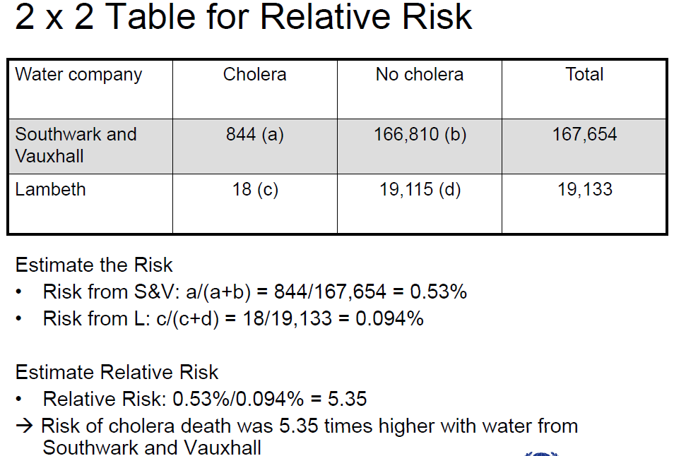

Slide 43
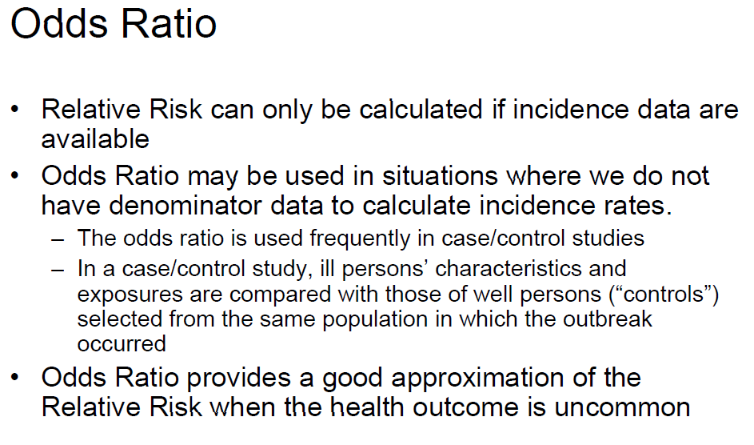

Slide 44
When OR is close to RR:
Rare disease assumption
RR= = = = OR
a/ (a+b)
a / b
ad
c/ (c+d)
c / d
bc
 | Disease | No disease
exposed | a | b
Nonexposed | c | d

Slide 45
The Confidence Interval for the Effect Size

Slide 47
Confidence Intervals
When an estimate is presented as a single value, such as an odds ratio, we refer to it as a point estimate of the population odds ratio. When we compute a confidence interval, we form a interval estimate of the value.
A confidence interval is called an interval estimate, which is a interval
(lower bound , upper bound)
that we can be confident covers, or straddles, the true population effect with some level of confidence.
The interpretation of a 95% confidence interval for the odds ratio is
(van Belle et al, 2004, p.86):
The probability is 0.95, or 95%, that the interval (lower bound , upper bound) straddles the population odds ratio.

Slide 48
Risk Difference / Attributable Risk
The risk difference (RD) or attributable risk (AR) is a measure of association that provides information about the absolute effect of the exposure or the excess risk of disease in those exposed compared with those nonexposed.
AR = IRe-IRo
Attributable fraction = =
Good to see the attribution of the exposure
RD
Re-Ro
R1
Re

Slide 49
Summary:
Objectives of the Course Program
1. Bias
2. Confounder
3. Chance
Study Design
Data collection
Epidemiology
Analysis: Statistical methods
Notes:
Sansin neden yeri var? Cunku hangi calismayi yaparsaniz yapin o konudaki butun bir evreni calismaniza dahil edemezsiniz. Yani uriner sistem infeksiyon cals, yapiyorsaniz siz bu infeksiyonlar ilgili dogru bir bulguya ulasmak istiyorsunuz sonucta, nasil tedavi edildigi veya risk faktoru vs. Ama hic bir zaman tum UTI hastalarini calisamazsiniz, isterseniz en buyuk kohortu elde edin yine de bu bir orneklemdir ve bu orneklemin secilmesinde raondomness sans isin icine girer. Yani o hasta degil be baska hasta, Orneklem sayiniz ne kadar kucukse sans da o kadar isin icinde dir Iste istatistigin en son basamakta size soyledigi de sansin buldugunuz bu sonuctaki yeridir O KADAR

