Slide 1
Types of Study Design and
Cohort Studies
Önder Ergönül, MD, MPH
Koç University, School of Medicine
Summer Course on Research Methodology in Health Sciences
June 11-22, 2016, Istanbul

Slide 2
The Stages of Study
Background
Hypothesis
Design
Data collection
Analysis
Report

Slide 3
RCT or
Meta-analysis
Expert opinion, descriptive, case series
Non randomized but controlled
Multicentric cohort or case control

Slide 4
Study Designs
Does investigator
decide for exposure?
YES
NO
Experimental
(interventional)
Observational
(non interventional)
Randomization?
Comparison
Group
YES
NO
YES
NO
RCT
Non-randomized
Controlled
Analytical
Descriptive

Slide 5
Study Designs
COHORT
exposure
outcome
Case-control
exposure
outcome
Cross sectional
Exposure
Outcome

Slide 6
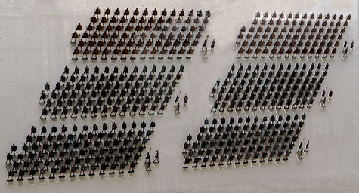
Cohort Studies
Roman cohort

Slide 7
Early Cohort Studies
Farr 1835 : On Prognosis, Lancet
John Snow 1854
Golderberger 1935 (case control/intervention)
Frost 1933

Slide 8
Cholera vs Tuberculosis
“Phthisis is more dangerous than cholera; but cholera, probably excites the greatest terror”
“Cholera destroys in a week more than phthsis consumes in a year”
William Farr, 1935

Slide 9
Prospective Cohort Studies
34,000 male British doctors
190,000 male and female American citizens with different smoking habits
Framingham
5,000 middle aged residents of Framingham with different blood pressures, blood cholesterol levels, etc.
1946 Birth Cohort
13,000 children born in the UK in one week in 1946 with different family backgrounds.

Slide 10
The History of Cohort Studies;
Tuberculosis in generations
The term "cohort study" was introduced by Frost in 1935
He aimed to describe the disease experience of people born at different periods, in particular the sex and age specific incidence of tuberculosis.

Slide 11
“Generation” or “Generation Cohort” Studies
Such studies were described as generation studies or generation cohort studies to distinguish them from the common descriptive studies.
Initially called prospective studies, because the information characterising the individuals in the cohorts was recorded before the onset of disease, they are now preferably called cohort studies and distinguished as prospective cohort studies.

Slide 12
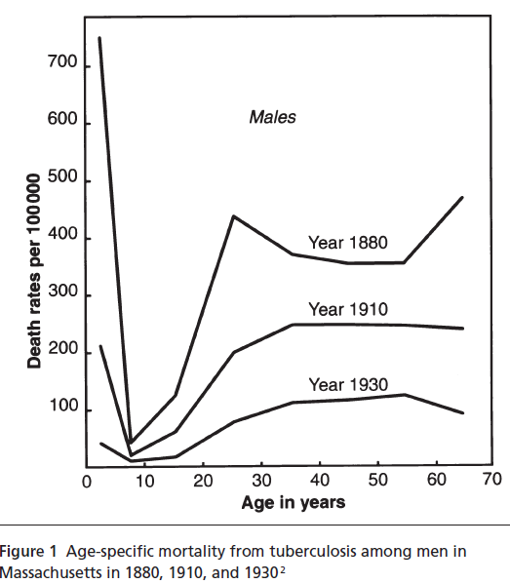
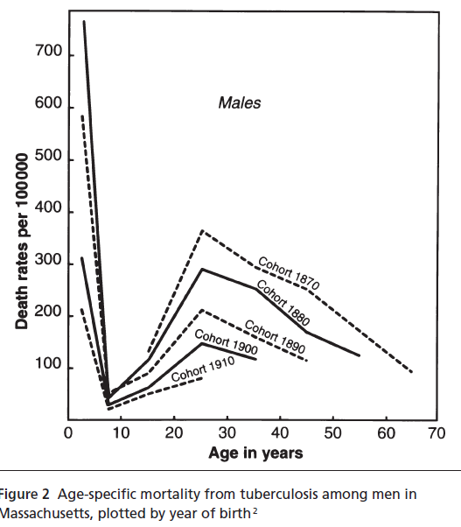
Mortality from Tuberculosis, Frost, 1935
Age Specific Mortality versus Generation Cohort
Frost WH. The age selection of mortality from tuberculosis
in successive decades. Am J Hyg 1939; 30: 91-6. Doll R, 2001

Slide 13
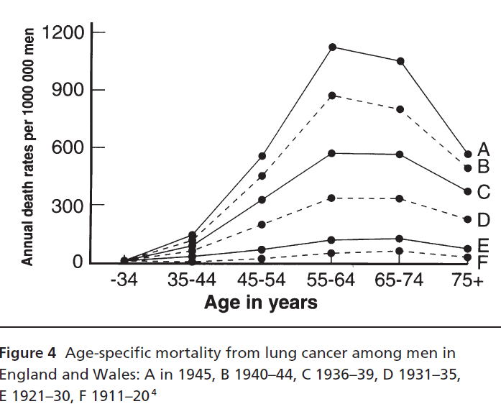
Lung Cancer Epidemics, Korteweg, 1952, Netherlands
Korteweg R. The age curve in lung cancer. Br J Cancer 1952; 5: 21-7

Slide 14
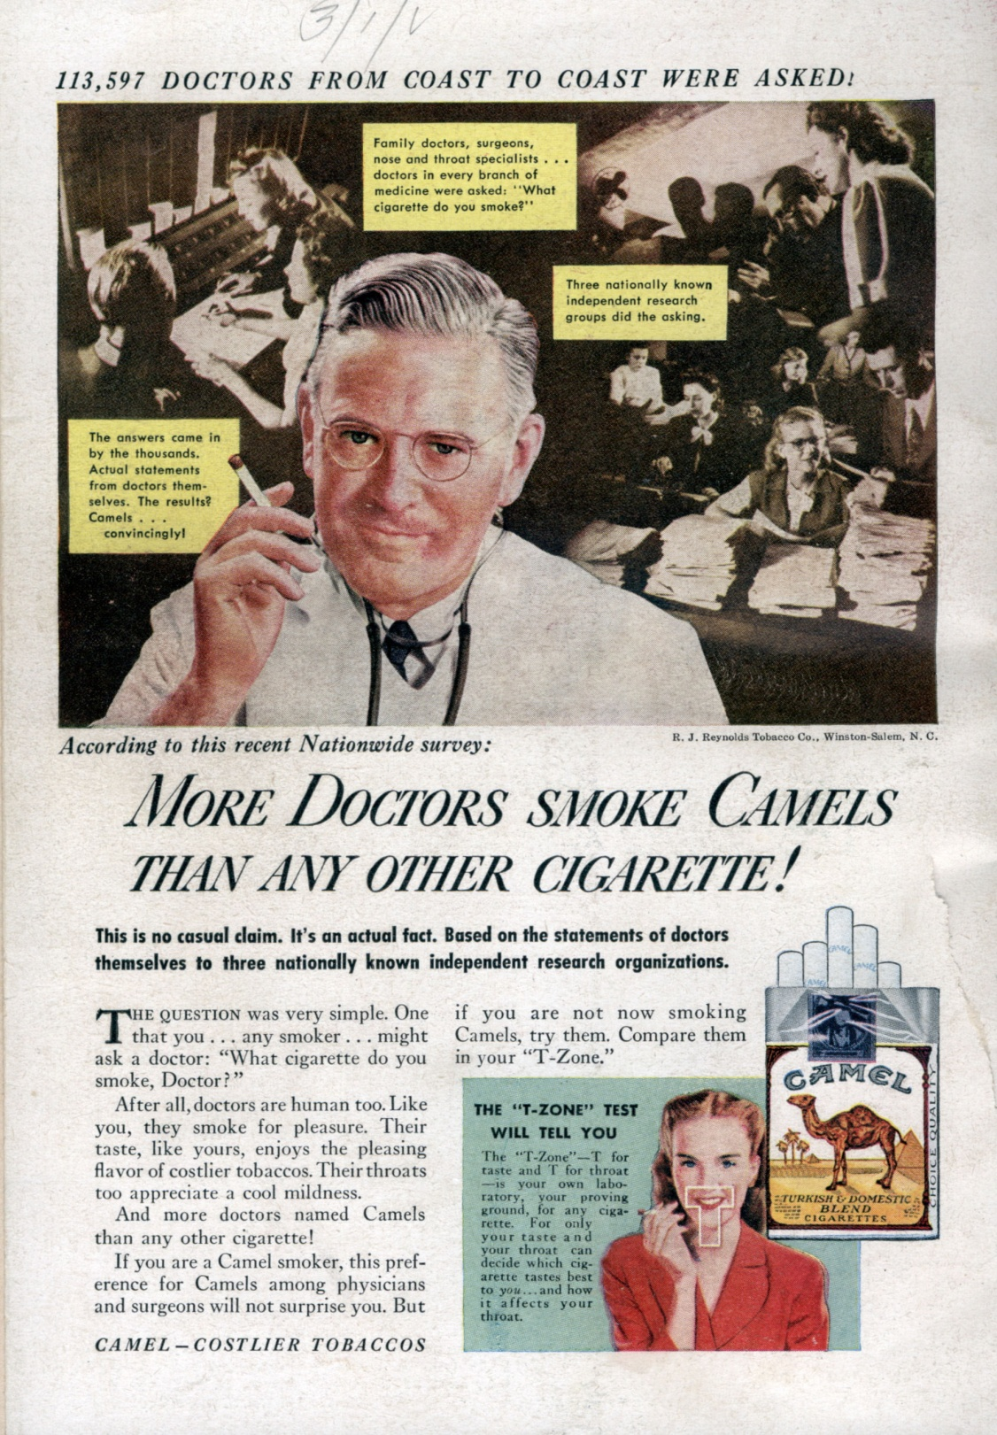
More doctors smoke
camels than any
other cigarette!
113,597 doctors
were asked
1946, USA
http://www.youtube.com/watch?v=gCMzjJjuxQI

Slide 15
Smoking is Fatal: British doctors study
Doctors: high response rate 40000/60000
1951
One page, 7 questions
Why 7 questions?
(An investigator should ask 5 times before including one question)
10 year follow up

Slide 16
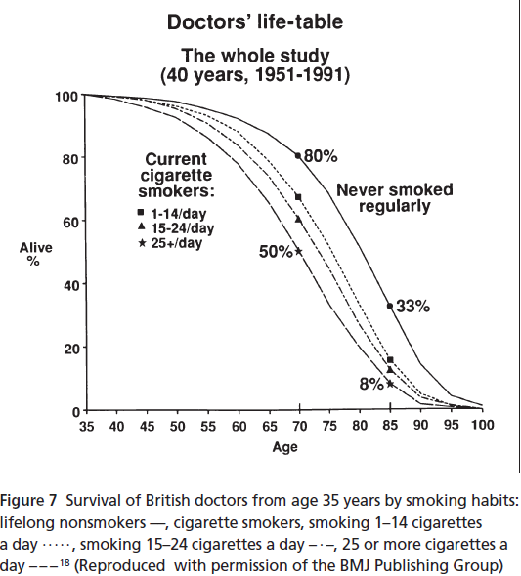
British doctors study

Slide 17

Framingham Heart Study

Slide 18
https://www.youtube.com/watch?v=HZpYkD_plPw

Slide 19
1960s: The Cohort Study Definition
10 years after Korteweg’s paper, the term cohort study began to be given the much wider meaning that it now has:
“any study in which groups of people with defined characteristics are followed up to determine in incidence of, or mortality from, some specific disease, all causes of death, or some other outcome.”

Slide 20
Exposure and outcome
exposure
NO
exposure

Slide 21
Incidence rate = incidence density
A / time
Number of new cases of a disease during a given period of time
CI =
Total person time of observation
 | Jan | Feb | March | April | May | June | Total Time at risk
A |  |  |  |  |  |  | 3 months
B |  |  |  |  |  |  | 6 months
C |  |  |  |  |  |  | 2 months
Total person time |  |  |  |  |  |  | 3+6+2=11

Slide 22
Study group
CNS infection
Schizophrenia
a
No Schizophrenia
b
No infection
Schizophrenia
c
No Schizophrenia
d

Slide 23
Relative Risk for Cohort Design
 | Schizophrenia | No Schizophrenia
CNS infection in childhood | a | b
No CNS infection | c | d
RR= a / (a+b) : c / (c+d)

Slide 24
The Confidence Interval for the Effect Size

Slide 25
Retrospective Cohort
Sonuç
(outcome)
exposed
Sonuç yok
Study group
Sonuç
Etkene maruz kalmayanlar (kontrol)
Sonuç yok
zaman
Onset of study
Araştırmanın yönü
Notes:
These studies are possible if the records on follow-up are complete and adequately detailed and if the investigators can ascertaint the current status of the patients.

Slide 26
Retrospective Cohort Studies
Spread of tuberculosis in families, Frost, 1933
Nickel refiners’ study, Hill, 1966
Gas workers’ study, Doll, 1952
Life span study of the atomic bomb survivors, Atomic Bomb Causalty Commission, 1956
Ankylosing spondylitis study, 1957

Slide 27
Cohort Effect
Certain illnesses may be socially affected and cohort effects can be an indicator of this sort of phenomenon.
Cohorts in organizations are often defined by entry or birth date, and retain some common characteristic (size, cohesiveness, competition) that can affect the organization. For example, cohort effects are critical issues in school enrollment.
In medical literature, cohort effect should be known to detect and/or avoid selection bias.
Birth cohort effect in LTBI in US (BMC Infect Dis 2010)

Slide 28
Biases in Cohort Studies
Bias in assessment of the outcome
Information bias
  Particularly in historical control
Biases from non-response and losses to follow up
Analytic bias

Slide 29
Cross-over study design
With outcome
With outcome
Experimental subjects
Experimental subjects
Subjects meeting entry criteria
Without outcome
Without outcome
With outcome
With outcome
Controls
Controls
Without outcome
Without outcome
Onset of study
Intervention
Washout
period
Intervention
Time

Slide 30
Factorial design
A factorial design is used to evaluate two or more factors simultaneously.
The advantages;
answer 2 or more questions in a single trial for
only a marginal increase in cost.

Slide 31
Factorial Design: The Physician’s Health Study
randomized
Aspirin
placebo
Beta carotene
placebo
aspirin
Beta carotene
Beta carotene
placebo
Beta carotene

Slide 32
Randomized Clinical Trials
Avoid the biases
  Misclassification
  Management of the confounders

Slide 33
Randomized controlled trial design
Experimental subjects
With outcome
Without outcome
Subjects meeting entry criteria
With outcome
Controls
Without outcome
Time
Onset of study
Intervention

Slide 34

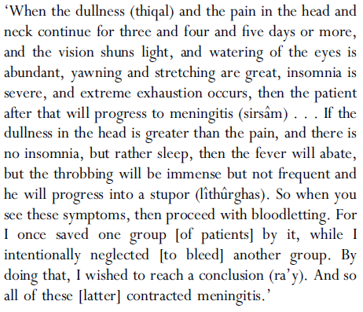

Slide 35
Randomization
First randomizasyon: Fisher, 1923
  Objective: The efficacy of different fertilizers
      Old method: compare different fields
      New method:
        Divide the field into small pieces
        Apply the fertilizers randomly

Slide 36
Randomized Clinical Trials
Randomization is not enough!
Intention to Treat (ITT)
Per Protocol (PP)

Slide 37
Intention to Treat Analysis
After randomization,
  The patients who did not receive treatment
  Deviations from protocol
  Include all the patients
Fisher LD, et al. Intention to treat in clinical trials. In: Pearce KE, ed. Statistical issues in drug research and development. New York: Marcel Dekker, 1990:331-350

Slide 38
Why ITT needed?
Since 1990s.
Fisher LD, et al. Intention to treat in clinical trials. In: Pearce KE, ed. Statistical issues in drug research and development. New York: Marcel Dekker, 1990:331-350
Check the similarities and differences of treatment and control arms.
Management of non-compliance and deviations

Slide 39
ITT is more realistic,
PP is falsely optimistic

Slide 40
What if ITT not performed?
If not performed, the efficacy could be found much better than expected (extremely optimistic)
Good for practical purposes, not for biologic explanation.
Possible if all the outcomes of randomized subjects are available.

Slide 41
Flow Diagram
Design
Analysis
Reading

Slide 42

“Make everything as simple as possible, but not simpler”

