Slide 1
Cross-sectional Studies
Pınar Ay, MD, MPH
Marmara University School of Medicine
Department of Public Health
npay@marmara.edu.tr

Slide 2

Learning Objectives
At the end of the session the participants will be able to:
define the design of x-sectional studies,
describe the measures used in x-sectional studies
explain the biases of x-sectional studies,
list the uses of x-sectional studies.

Slide 3
Epidemiological Studies
Observational
Experimental
Randomized Controlled Trials
Quasi Experimental
Descriptive
Analytical
Cohort
Case-control
Cross-sectional
Ecological

Slide 4
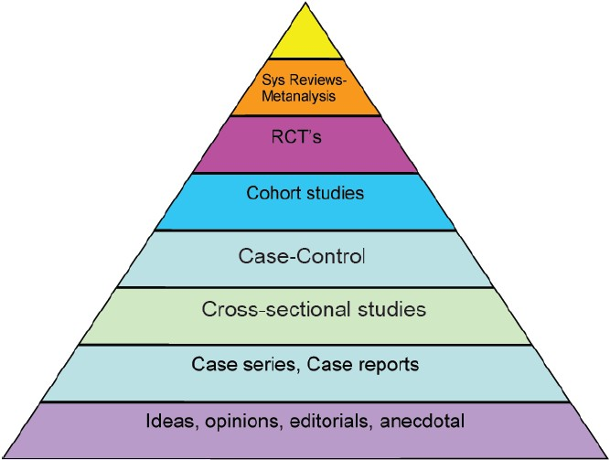
Hierarchy of evidence

Slide 5
Cross-sectional (Prevalence) Studies
A cross-sectional study provides information about a health condition / disease that exists at a given time/during a given period.
Descriptive
Analytical

Slide 6
Design of Cross-sectional Studies
Defined Population
Gather data on exposure and disease
Exposure -
Outcome -
Exposure +
Outcome -
Exposure +
Outcome +
Exposure -
Outcome +

Slide 7
CROSS-SECTIONAL STUDIES DON’T HAVE A DIRECTION
Cohort
Exposure
Outcome
Cross-sectional
Case-control

Slide 8
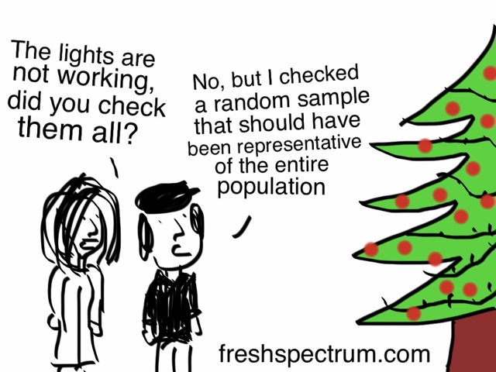
Sampling strategy
In cross-sectional studies the sample should be representative of the study population.
1. Sample size
2. Sample design

Slide 9
Sample Size
Once upon a time a researcher was presenting the findings of a trial where he assessed the effectiveness of a new drug for sheep.
‘After administering the drugs’ he said ‘one third of the sheep improved significantly, one third did not show any change, and the last one ran away’

Slide 10
Sample size
The sample size for an estimation is determined by the assumptions and the precision required.
There should be a high probability
that the estimate is close to
the true value
≈ 95% confidence
margin of error

Slide 11
Example
To estimate the mean systolic blood pressure for adults with a margin of error of 1 with 95% confidence. (sd=15mm-Hg)
Margin of error: 1
Confidence: 95%
Sd: 15 mm-Hg
If the mean is120 mm-Hg
119 120 121

Slide 12

Estimating a population mean
standard deviation
Z score: the distance from the mean of a stipulated probability, in sd units, of a hypothetical normal distribution with a mean of 0.
Z_{α/2} : Z score associated with the stipulated level of α.
margin of error
sample size needed

Slide 13
Example
To estimate the mean systolic blood for adults with a margin of error of 1 with 95% confidence. (sd=15mm-Hg)
Margin of error: 1
Confidence: 95%
Sd: 15 mm-Hg
n = (1.96 x 15 / 1)²
n = 866

Slide 14

Estimating a population proportion
1-p
estimate of the population proportion
margin of error
sample size needed

Slide 15
Example
To estimate the proportion of hypertensive adults with a margin of error of 0.05 with 95% confidence. (p=20%)
Margin of error:0.05
Confidence: 95%
p = 20%
n = (1.96/0.05)² (0.20 x 0.80)
n = 246
If we have no idea of p, then assume p=50%

Slide 16
Sampling design
Probability sampling is one in which every member of the population has a known and nonzero probability of being selected into the sample.
Simple random sampling
Systematic sampling
Stratified sampling Probability sampling
Cluster sampling
Multi-stage sampling

Slide 17

Simple Random Sampling
Each member of the population has an equal chance of being selected.
We need a sampling frame (list of all members of the population from which the sample is to be drawn)
Sampling frame should be current and accurate.

Slide 18
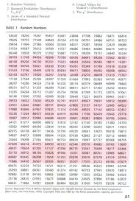

Methods of simple random sampling
Lottery
Table of random numbers
Computer programs

Slide 19
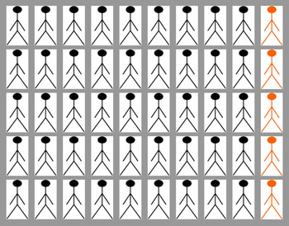
Systematic sampling
It is used when elements can be ordered.
A selection interval (n) is determined, by dividing the total population listed by the sample size.
A random starting point is choosen and every nth person is selected

Slide 20
Stratified sampling
The target population is divided into suitable, non-overlapping strata.
Each stratum should be homogenous within and heterogenous between other strata.
A random sample is selected within each startum
Each stratum is more accurately represented
Separate estimates can be obtained for each stratum, and an overall estimate can be obtained for the entire population

Slide 21

Cluster sampling
It is used when the population is geographically dispersed or when a sampling frame is not available.
Units first sampled are not individuals, but clusters of individuals
Looses some degree of precision so design effect should be used.
Villages
Neighborhoods
Households Clusters
Schools
Factories

Slide 22
Non-response bias
Non-respondents / nonparticipants may bias the findings because respondents and non-respondents may differ with respect to what ever is being studied.
Compare the demographic characteristics of the respondents with those of the non-respondents

Slide 23
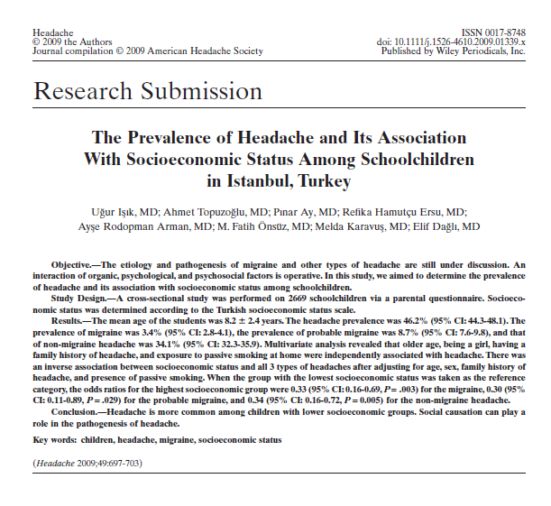

Slide 24
THE PREVALENCE OF HEADACHE AND ITS ASSOCIATION WITH SOCIOECONOMIC STATUS AMONG SCHOOLCHILDREN IN ISTANBUL, TURKEY

Slide 25

Prevalence
‘Stopping the clock’ and assessing disease/attribute frequency at a point of time
Fixed calendar time
Number of prevalent cases
Prevalence = x k
Number of individuals studied

Slide 26
Prevalence
Point prevalence
Period prevalence
Number of prevalent cases
in the stated time period
Period Prevalence = x k
Population at risk
Average size of the population during the specified period

Slide 27
Point vs. Period Prevalence
Question | Measure
Do you currently smoke? | Point prevalence
Have you had smoked during the last (n) years? | Period Prevalence

Slide 28
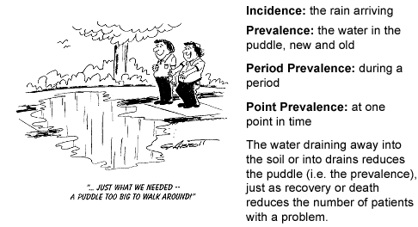
Incidence vs. Prevalence
Incidence rates: measure the occurrence of new cases of a disease/other events
Prevalence rates: measure the presence of a disease/other events

Slide 29
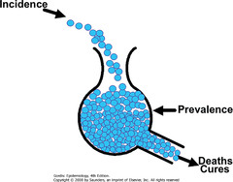
Incidence and Prevalence
Prevalence = Incidence x mean duration of disease

Slide 30
Measures of Associations
Exposure | Outcome Yes No Total
Yes | a | b | a+b
No | c | d | c+d
Total | a+c | b+d | n
OR = (a/c) / (b/d)
= ad/bc

Slide 31
Measures of Associations
Exposure | Outcome Yes No Total
Yes | a | b | a+b
No | c | d | c+d
Total | a+c | b+d | n
If the factor is a risk factor
Excess risk among exposed: a/(a+b) – c/(c+d)
Attributable fraction (exposed): [a/(a+b) – c/(c+d)] / [a/(a+b)] x 100
Attributable fraction (population): [(a+c)/n – c/(c+d)] / [a+c)/n] x 100

Slide 32
Measures of Associations
Factor | Outcome Yes No Total
Yes | a | b | a+b
No | c | d | c+d
Total | a+c | b+d | n
If the factor is a protective factor
Excess risk among unexposed: c/(c+d) - a/(a+b)
Prevented fraction (exposed): [c/(c+d) - a/(a+b)] / [c/(c+d)] x 100
Prevented fraction (population): [c/(c+d) - (a+c)/n] / [c/(c+d)] x 100

Slide 33
Which measure to use?
Causal relationships
Magnitude of a health problem
ORs
Prevalence, Differences
between prevalances
What are the treatment costs?
What is the impact on productivity?
How many people have the disease in a population because of the exposure?

Slide 34
Data collection methods
Clinical observations and special tests
Interviews and questionnaires
Clinical records and other documentary sources
Prevalence studies should use more than one method and combine the findings

Slide 35
Capture-recapture analysis
Prevalence surveys that use more than one method and combine the findings
Originally used in estimating animal populations

Slide 36



Capture-recapture
1. Mark and release a batch of captured fish
2. Calculate how many are recaptured in the next batch

Slide 37
Capture recapture
  n₁ = number in first sample
  n₂ = number in second sample
  n_{total} = number in two samples
  N = total population size
  N = [(n₁+1) (n₂ +1) / (n_{total} +1)] -1

Slide 38
Estimating problem drug use in Ankara, Istanbul and Izmir
Aim: to estimate the prevalence of PDU at a local level, in the three cities Ankara, Izmir and Istanbul.
Methods: Capture-recapture method was used to estimate the number of problem drug users,
Data was available from:
the Ministry of Interior – Turkish National Police,
the Ministry of Justice – Prisons and Detention
Houses,
the Ministry of Justice – Probation Services,
the Ministry of Health, the Ministry of Social Affairs – Social Security Institution.

Slide 39
Estimating problem drug use in Ankara, Istanbul and Izmir
Data include a personal ID code, demographic information such as age, gender and region, and, depending on data source, diagnosis of substance use disorders or type of drug use.
The total number of opiate-related cases is 2,637 in Ankara, 7,094 in Istanbul and 235 in Izmir, respectively.

Slide 40
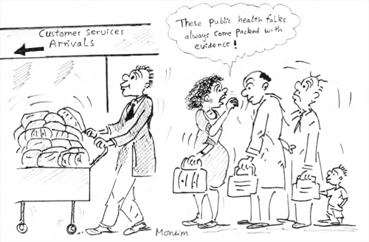
Uses of X-sectional Studies
Community Health Care
Community diagnosis
Surveillance
Community education and community involvement
Evaluation of community’s health care
Clinical Practice
Individual care
Family care

Slide 41

Uses I: Community Diagnosis
1
Define the Health Problems in the Community and the factors that influence it
2
Prioritize the Health Problems and Select one Problem
3
4
Evaluate the Intervention
Develop and Implement an Intervention

Slide 42
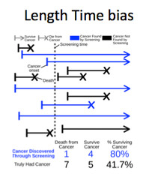
Length Time Bias
Point prevalence provides an incomplete picture due to underrepresentation of conditions with short duration.
Famine in Chad in 1985
Cross-sectional study
Severe malnutrition among children did not exist!
Many children died too soon to be included in the survey.

Slide 43
Uses II: Determinants of health and disease
The aim is what causal factors or correlates are active in the specific community and to measure their impact.
The primary aim is not to generate new knowledge about etiology
The presence of both exposure and disease is determined simultenously, so often it is not possible to establish a causal relationship

Slide 44
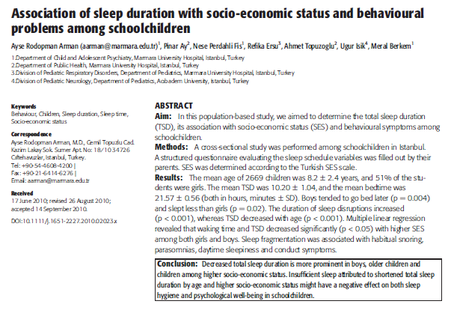

Slide 45
Uses III: Intervention and Policy Decisons
Measures of impact:
Basis for intervention and policy decisions
Attributable fraction in the population
Prevented fraction

Slide 46
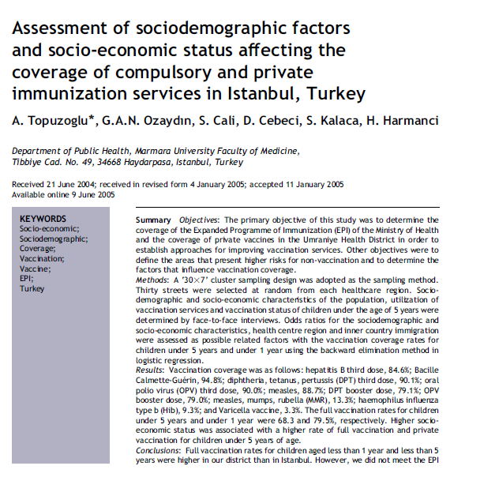

Slide 47
Uses IV: Surveillance
Ongoing surveillance: identification of changes in health status and its determinants in the community
Repeated cross-sectional studies: but does not indicate changes in the risk of developing the disease
Interplay of of incidence, recovery and fatality rates
Changes in the demographic aspects
Changes in methods of case identification, use of medical services, diagnostic procedures, recording, notification or registration practices

Slide 48
Temporal trends in overweight and obesity of children and adolescents from nine Provinces in China from 1991-2006.
OBJECTIVES:
To assess temporal changes in mean body mass index (BMI) and the impact of socio-economic status on the prevalence of overweight and obesity among Chinese children and adolescents in nine provinces between 1991 and 2006.
METHODS:
Analysis of height and weight data in children and adolescents aged 7-17 years with complete information on age, gender, region, height and weight from consecutive China Health and Nutrition Surveys (CHNS). CONCLUSIONS:
The prevalence of overweight and obesity among Chinese children and adolescents has increased steadily over the past 15 years with the increase being apparent in all age, sex and income groups.

Slide 49
Uses V: Evaluation of a Community’s Health Care
Form a basis for decisions about the provision of care;
Compliance for medical advice,
Satisfaction with medical care
A special attention should be given to population subgroups because the impact of health programe varies with age, gender, social class etc.

Slide 50


