Slide 1
Introduction to Health Economics (1)
Tara Lavelle, PhD
Assistant Professor
Tufts University
June 25, 2019

Slide 2




Our Community

Slide 3
Agenda for Today
Why do we need health economics?
Types of economic evaluation and use throughout world
Introduction to cost-effectiveness analysis
Notes:
Stepwise logic:
BURDEN What conditions are the greatest contributors to burden in your setting; may not be those getting the most press or gov’t attention
EFFECTIVE SOLUTIONS Essentially, what interventions produce the optimum health gain (we’ll talk about how to measure that appropriately in a bit)
COST EFFECCTIVENESS If you need to invest additional monies in an intervention, how do you know it’s “worth it”?

Slide 4
Why do we need health economics?
Setting priorities for global health

Slide 5
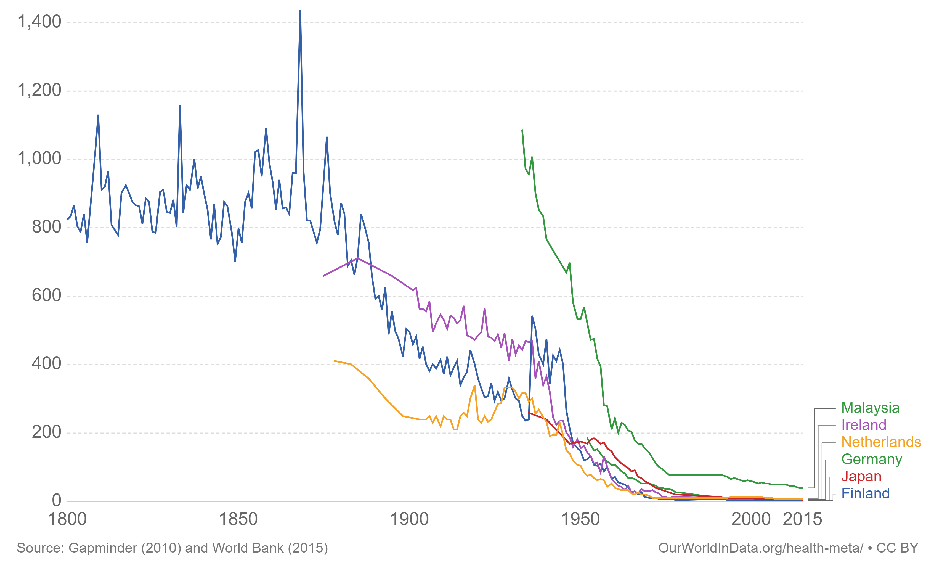
Maternal Mortality: deaths per 100,000 live births

Slide 6
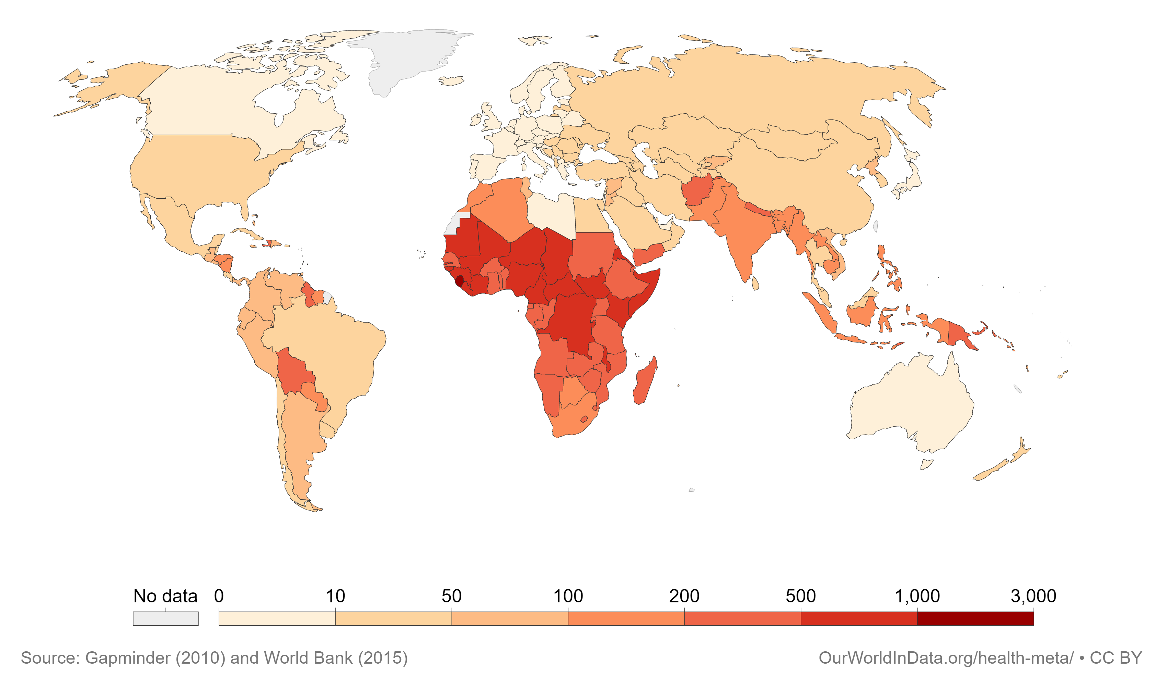
Maternal Mortality: deaths per 100,000 live births
2015

Slide 7

Maternal Mortality in Developing Countries
Every day, approximately 830 women die from preventable causes related to pregnancy and childbirth
99% of all maternal deaths occur in developing countries.
Higher rates in rural areas and poorer communities
Sustainable Development Goals: reduce the global maternal mortality to < 70 per 100 000 live births by 2030

Slide 8
How do we get there?
Effective interventions:
Family Planning
Prenatal care
Skilled birth attendants
Accessible health facilities
But resources are limited: what to prioritize?
What information should be considered as part of this decision?

Slide 9
Vaccine policy decision in the U.S.
Herpes zoster(shingles) is an infection that causes a painful rash
1 million cases of annually in U.S.
Until recently only available vaccine (Zoster Vaccine Live) was relatively ineffective after 10 years.
A recently approved vaccine–herpes zoster subunit (HZ/su)–can prevent shingles for significantly longer.
But… it’s more expensive than old vaccine ($280 vs. $213)

Slide 10
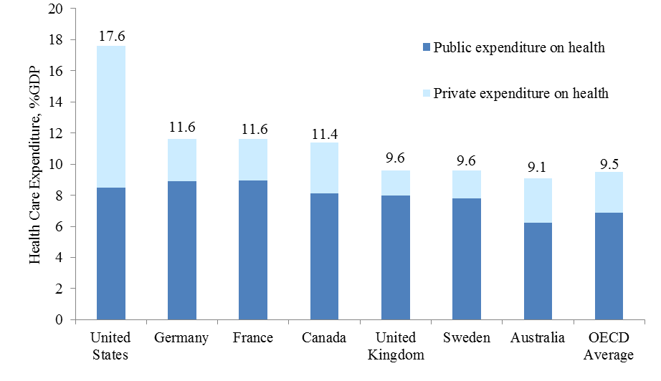
Why does that matter?
Worrying trend in health care spending

Slide 11
Policy questions:
  For those that have never been vaccinated against shingles, should they receive the old vaccine or the new vaccine?
  For those that have already been vaccinated with the old vaccine, should they now receive the new vaccine?
What information should the US Centers for Disease Control
consider as part of their policy recommendations?

Slide 12
Rational for use of health economics in decision making
A decision must be made
  How to prevent maternal mortality?
  What vaccine to recommend?
How do we do it most efficiently to provide biggest health gain for money invested given budget constraints

Slide 13
Health Economics Course Overview

Slide 14
Health Economics
Three sessions:
  June 25: 2:30-4:30pm
  June 26: 1:00-3:00pm
  June 27: 1:00 -3:00pm
Expectations:
  Engage, ask questions!

Slide 15
Economic Evaluation in Public Health
Topics
Part I: Introduction to health economics and health economic evaluation
    Types of health economic evaluations
    Uses of economic evaluation internationally
Part 2: Health State Valuations
    QALY
    DALY
Part 3: Cost-effectiveness methods
    Conducting a simple CEA
    Using models and RCT to conduct a CEA
    Uncertainty in CEA
    Decision rules in health economic evaluation

Slide 16
Health Economics 101

Slide 17
Health economics
Study of the distribution of health care
Study issues related to scarcity in the allocation of health care resources
  What should we spend our money on to provide better health care?
  Question: Why do we care about scarcity?

Slide 18
Scarcity
Society’s resources are limited
Cannot produce all goods and services it desires
Need to make choices of how to allocate available resources

Slide 19
Economics is about choice given limited resources
Good ‘A’
Good ‘B’
Budget
We make this choice with help of economic evaluation
Notes:
93

Slide 20
Economic evaluation of health care programs
Consequences of
program A
Program
A
Cost of program A
Choice:
A or B?
Program
B
Cost of program B
Consequences of
program B

Slide 21

Economic evaluation
Comparative analysis of competing options in terms of both their costs and consequences
Source: Drummond et. al.

Slide 22

Everyday examples…

Slide 23
Types of Economic Evaluation

Slide 24
Types of economic evaluation
Cost Minimization Analysis (CMA)
Cost Effectiveness Analysis (CEA)
Cost Utility Analysis (CUA)
Cost Benefit Analysis (CBA)

Slide 25
Types of health economic evaluations
Cost-minimization
  Difference in cost between two interventions when effectiveness is equal
Cost-effectiveness analysis (CEA)
  Incremental cost effectiveness ratio (ICER)
  Difference in cost between interventions, divided by difference in health outcomes
  Outcomes can be measured as clinical events, life years, disability life years (DALYs)
Cost-utility analysis (CUA)
  CEA that measures outcomes as quality adjusted life years (QALYs)
Cost-benefit analysis (CBA)
  Assigns a monetary value to health outcomes (e.g. life years gained as $)
  Calculates net benefit ($) = total benefit ($) - total cost ($)

Slide 26
Use of economic evaluations by field
Field | CEA/CUA | CBA
Public Health | Common | Common
Clinical Medicine | Common | Rare
Environmental Health | Rare | Common
Education | Rare | Common
Transportation | Rare | Common

Slide 27
Use of Health Economic Evaluation
throughout the world

Slide 28
Who cares about cost-effectiveness?
Governments
Philanthropic foundations
Medical Specialty Societies
Pharmaceutical companies: support marketing and coverage decisions (potential bias)

Slide 29
Government
  Health Technology Assessment (HTA)
    HTA is a systematic approach to evaluate new health interventions to inform policy decision making:
      safety, clinical effectiveness (most)
      economic and budgetary impact (some)
  48 countries currently have established economic evaluation guidelines
  UK:
    National Institute for Health and Care Excellence (NICE)
      HTA review before every drug/device covered by NHS with cost-effectiveness analysis
      Effectiveness AND cost-effectiveness
    Country CEA guidelines: https://tools.ispor.org/peguidelines/

Slide 30

US government: problems with cost-effectiveness

Slide 31


Developing Countries
Disease Control Priorities: Finding the most effective and cost-effective solutions
Notes:
Disease Control Priorities provides a periodic review of the most up-to-date evidence on cost-effective interventions to address the burden of disease in low-resource settings.
What you’ll find in each volume …
While each volume has a structure and content specific to its topic, volumes contain the following sections.
Burden – a review of the disease burden for each topic.
Effective Interventions –evidence for health and intersectoral policy interventions that have demonstrated effectiveness, feasibility, and cost-effectiveness in low-resource settings
Economic Analysis –A presentation of the relevant costing, cost-benefit analysis, cost effectiveness analysis and extended cost effectiveness analysis, both from the literature and newly conducted for DCP3.
These have been important contributions but they are static in time
We don’t know if there will be a next iteration!
Need for ongoing resources as new information becomes available

Slide 32


Philanthropic Foundations
Mission
www.ghcearegistry.org
Aggregate, curate, and improve the world’s cost-effectiveness information to enhance global health
Notes:
Developed starting in 2015

Slide 33

Medical Specialty Societies: Clinical Guidelines
Mission

Slide 34
Introduction to cost-effectiveness analysis

Slide 35
Cost-effectiveness analysis
Measure difference in total costs between programs
Measure difference in benefits/health effects
Create a ratio costs/benefits
Health effects can be measured in many different ways: lives, heart attack, stroke, life years, quality adjusted life years (QALYs)

Slide 36
Cost-effectiveness analysis
Cost-effectiveness ratio
Net increase in health care costs
Net gain in health benefit

Slide 37
Cost-effectiveness analysis
Cost-effectiveness ratio
Net increase in health care costs
Net gain in health benefit

Slide 38
Cost-utility analysis
Cost-effectiveness ratio
Net increase in health care costs
Net gain in quality adjusted life year (QALYs)

Slide 39
Preview: The Quality Adjusted Life Year
Combines longevity with the quality of life into a single metric
Weights duration of time spent in a health state by the quality of life of that health state:
    Full health = 1.0
    Death = 0
  Health state: The health of an individual at any particular point in time. [Gold et al 1996]

Slide 40
The Quality Adjusted Life Year
Hearing loss
QALY calculation
1yr*0.7 = 0.7 QALY

Slide 41
The Quality Adjusted Life Year
Hearing loss
Treatment

Slide 42
The Quality Adjusted Life Year
Full Health
Hearing loss
QALY calculation
0.5yr*0.7+ 0.5yr*1 = 0.85 QALY

Slide 43
Incremental Cost-effectiveness Ratio ($/QALY)
QALYs with treatment
QALYs without treatment
0.15 QALYs gained with treatment
0.85
0.7
Additional costs with treatment
$1,000
$1,000
Cost
$6,667 per QALY gained
QALYs
0.15 QALYs
Would a lower ratio be better or worse?

Slide 44


What are some possible outcomes of CEA?
Difference in program effectiveness
Incremental costs and effectiveness of B versus A
1000
1000
800
Quadrant II
800
Quadrant I
600
Δ
600
Δ
C > 0,
C > 0,
Δ
Δ
C > 0,
C > 0,
400
Δ
400
Δ
E < 0
E < 0
Δ
Δ
E > 0
E > 0
200
200
Incremental costs
Difference in program costs
0
-1
0
-1
-0.8
-0.8
-0.6
-0.6
-0.4
-0.4
-0.2
-0.2
0
0.2
0.2
0.4
0.4
0.6
0.6
0.8
0.8
1
1
-200
Quadrant III
-200
Quadrant IV
-400
Δ
-400
Δ
C < 0,
C < 0,
Δ
Δ
C < 0,
C < 0,
-600
Δ
-600
Δ
E < 0
E < 0
Δ
Δ
E > 0
E > 0
-800
-800
“Dominant”
-1000
-1000
Notes:
Note incremental

Slide 45
Economic Evaluation in Public Health
Topics
Part I: Introduction to health economics and health economic evaluation
    Types of health economic evaluations
    Uses of economic evaluation internationally
Part 2: Health State Valuations
    QALY
    DALY
Part 3: Cost-effectiveness methods
    Conducting a simple CEA
    Using models to conduct a CEA
    Uncertainty in CEA
    Decision rules in health economic evaluation

Slide 46
Questions?
  tlavelle@tuftsmedicalcenter.org

